Slide 1
Co-Creating a common Data language To Empower Citizens of the Web
In the hopes of bringing about a more collaborative open social web

Slide 2
Context
Amongst much conversation over the last few years between individuals working within Enspiral, Sensorica, Metamaps, Edgeryders, other networks, and many ‘freelancers’ too, there is a collaborative project (termed Value Flows) gaining traction. It has the potential to enhance the various web platforms we have been building to act more so as an ecosystem of tools, than siloed off platforms.
This presentation is meant to serve as a (mostly) non-technical portal into that conversation and an invitation to refine and support the emergent vision.

Slide 3
What is Value flows?
an unintelligible mess of technical semantic web jargon buried in github repositories and wikis?
a set of common vocabularies to describe flows of economic resources of all kinds within distributed economic ecosystems? link
an opportunity made possible by the knowledge, awareness, and passion of a group of renegade geeks and developers who want to empower our networks and all people?
a common language that can be spoken and understood by our various web platforms?

Slide 4
Hint: It was ‘E. All of the above’
…but let’s focus on the least technical of those explanations
Value Flows is a common language that can be spoken and understood by our various web platforms
(and any others that might emerge)
this presentation will discuss the power and opportunities that the above represents
(*for anyone who might wonder, there is an awareness of IEML and Ceptr and openings for aligning with these compatible languages/technologies)

Slide 5
Structure of the presentation
why not just stick with “the internet we know”?
the REAL problem Value Flows helps solve
What actually IS this “common language”?
Why could it work?
Who would learn this language?
* Leverage Point *
Demo Time
What could be the steps forward?
Who’s behind it all?
Challenges & Opportunities for the ecosystem

Slide 6
Addressing a real problem of todays web
As a "citizen of the web" it does not make sense for me to be constrained to access and alter my digital information via a finite number of prescribed interfaces

Slide 7
interfaces - core principle
Depending on who you are, and what you are trying to do, a different interface may be OPTIMAL

Slide 8
interfaces
An interface designer enables an interface consumer to
ACCESS and ALTER their data
view more background on interfaces here, where we explore Graphical User Interfaces, Application Programming Interfaces, and Command Line Interfaces: https://docs.google.com/presentation/d/1-V0yo0amXT5HXISAkcW-UPyefw4cDfdHltgxhLHZftQ/edit?usp=sharing

Slide 9
Core challenge #1
Getting the less tech-savvy people to understand what the possibilities are beyond traditional platforms and to evolve to the model of data + user interfaces instead, becoming co-designers, taking co-responsibility for the data and interfaces that can meet their needs

Slide 10
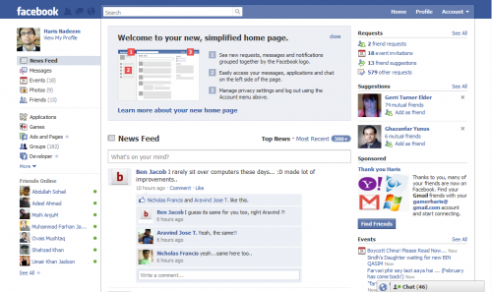
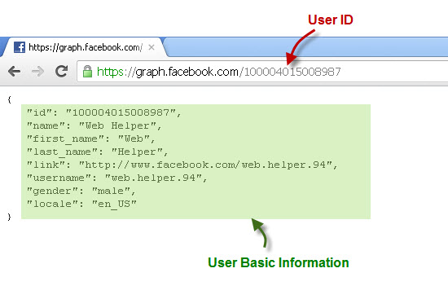
Example of Poor End User Experience
They do enable accessing and altering some of the data stored in facebook using the HTTP API, but they have legal limitations on building alternate interfaces to access and alter that data.
From one perspective, it looks like facebook has built a very functional graphical user interface. But a functional interface that helps the user do what? Only what they want the user to do. And we have reason to question their intentions.

Slide 11
Core challenge #2
Between the various web platforms that we have been building, our data is stored so differently that our various interfaces cannot work for/with the data of others. In other words, we are speaking different languages and struggling to communicate

Slide 12
Two Options
We have two options for Challenge #2.
We either:
keep storing our data in separate places in separate languages, but begin to write translations from one “language” to another
begin adapting our platforms to speak a shared language

Slide 13
The beginnings of a solution to core challenge #2
This proposed solution takes the form of option 2, creating a shared language and beginning to speak it. Yet, I also believe that there is room and a certain logic for option 1 to begin happening as well, on parallel tracks.
Proposal
By co-designing a flexible enough language that all of our web platforms can speak we unlock diverse opportunities to empower "citizens of the web" to access and alter their data in optimal ways.

Slide 14
People and groups
An extremely common use case of a web platform aiming to enable decentralized groups to work together is having to manage people and their formation into groups. Currently, all the web platforms handle this separately and redundantly. In the model being suggested with Value Flows, there would be diverse ways to alter these memberships, but the changes would permeate to the ecosystem of interfaces.
Requirement: a common language to describe people and relationships between, and participation and roles within groups

Slide 15
What is this "common language"
Put into dense, but at least human readable, terms:
It is a computer-readable way to describe discrete concrete and abstract things/entities, which can be expressed in the various code languages of the semantic web. (XML, JSON-LD, etc.)

Slide 16
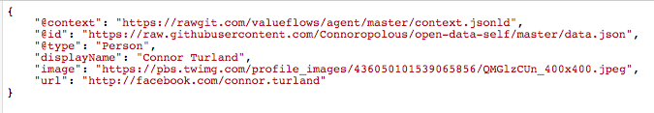
Expressed as JSON-LD, It looks like this

Slide 17
What else should I know about it?
In the Value Flows terminology, and JSON-LD terminology the term for this "common language" being defined is a "vocabulary".
The vocabulary will not be formed all at once, as it takes work to define a "type of thing". Due to the initial focus on enabling economic activities the initial ones being worked on are "agent", "process" and "exchange".

Slide 18
Why might it work?
JSON is one of the most used ways of transferring data on the web, so it already has wide adoption and familiarity.
Storing the JSON in files makes it both
- inherently portable, because you just copy and move the file
- familiar enough to people that they can handle it
Creating a "standard" is a tried and true way of creating compatibility between projects

Slide 19
A language gets useful when people speak it
So who would have to learn this "common" language?
To begin with...
App Developers - must build apps that read and write data in this special format, so those apps become compatible
Early Adopters of those apps - may find themselves staring at a raw JSON file that describes themselves, or an asset of theirs, and wish to share it or alter it in some way

Slide 20
Core challenge #4
Getting app developers and early adopters to "speak our language" may be difficult because it is unfamiliar and complex

Slide 21
* leverage point *
Framing Question: How can we help app developers to "speak our language"?
Answer: By writing open-source reusable code libraries in the languages most commonly used to build web apps that do most of the heavy lifting. A.k.a. act as a translator between a language familiar to the developer and our language. Initial proposed languages: Nodejs, RubyOnRails, and Django.
Would this be a huge task? No. In fact, I've already partially written a prototype of a Nodejs one. https://github.com/valueflows/linked-data-creator-api

Slide 22
A quick demo to ground this
go check out a demo: https://docs.google.com/presentation/d/18vz1hNP_gBtgVFN-oi_lQj8st8LS48sN5_sC4swOocQ/edit?usp=sharing

Slide 23
Back to interfaces
Insert stack interface diagram

Slide 24
Back to interfaces
conversational interface example
Tibi posted a new task that fits your skills:
Work required: 3D design, Estimated duration: 1 Hour
Due: Nov. 24, 2015
for Process: Robo Leaknet Cycle 1 starting 2015-11-24 ending 2015-12-15
This message has most likely been sent to other individuals.
IF you want to take the task, you can, but if not others will take it.
First-come-first-served.
Process Robo Leaknet Cycle 1
Reply
You committed to do this by Nov. 24.
It is now Dec. 5. What’s happening?

Slide 25
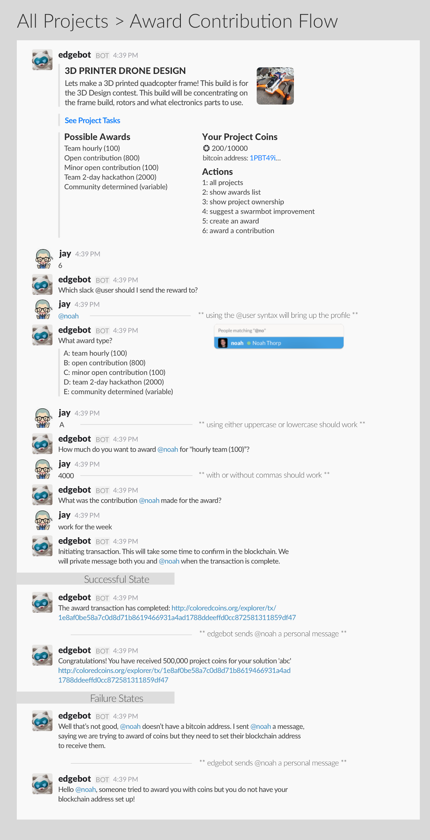
Back to interfaces
conversational interface example

Slide 26
Back to interfaces
Insert visual interface example

Slide 27
Steps to make it happen

Slide 28
Who's behind it
Mikey Williams
Simon Tegg
Elf Pavlik
Bob Haugen
Lynn Foster
Jon Richter
Elio Qoshi
Connor Turland
… (add your name here)
Projects which Value Flows originate from include the NRP project, and the Open App Ecosystem project

Slide 29
Challenges for the ecosystem
- core challenge #1 remains: breaking the familiar mental model of web interfaces, and mitigating the risks of being an early adopter
- core challenge #5: communicating well enough, within our own networks and/or beyond, the exponential power of focusing on creating low-level interfaces to attract resources to support that development and design work
- early adopters and system administrators are likely to have to brave raw data, and the github UI in the short term

Slide 30
Opportunities for the ecosystem
- build towards a "division of labor" in which we as an ecosystem don't have too many people writing code that does the same thing, and let peoples specific strengths shine
- empower our users with "hylo data" in Metamaps, "cobudget data" in Hylo feeds, Backfeed reputation being associated with NRP users, the list goes on!
- be leaders in the transition of web platforms towards personal ownership of data
- pave the way for this ecosystem to grow, as anyone would be empowered to build on and interact with what we have so far

Slide 31
Places to join the conversation
Slower paced, more accessible discussion (we hope):
https://gitter.im/valueflows/welcome
Firehose (sometimes):
https://gitter.im/valueflows
The top level Value Flows github repository (raise an issue):
https://github.com/valueflows/valueflows

